Slide 1
Projects Overview
Vinod Rajendran
M.Sc. Informatik
Technical University of Munich

Slide 2
Agenda
Million Song Dataset
SAP for KIOSK
SAP for Healthcare
Visualization of iAnn Events
Seminar: NLP on Legal Science
Work Experience in TCS & Allianz

Slide 3
Million Song Datasets

Slide 4
Overview
The Million Song Dataset :
- cluster of complementary datasets contributed by the community:
SecondHandSongs dataset -> cover songs
musiXmatch dataset -> lyrics
Last.fm dataset -> song-level tags and similarity
Taste Profile subset -> user data
Genre Classification

Slide 5
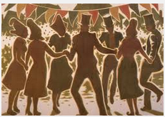
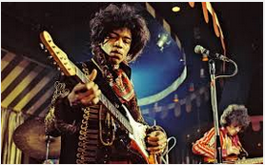
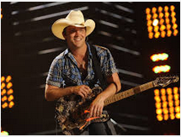

Genre Classification - Example
Test Lyrics
...
Folk
Rock
Country
Pop

Slide 6
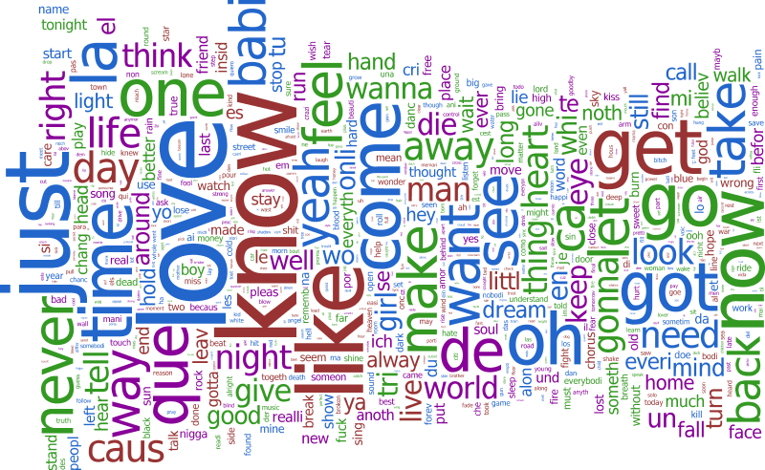
Pre-processing
Data Merging
Audio Data (from Million Song subset)
Last fm Dataset
Lyrics Dataset
Data Cleaning
Stemming of Words.
Removal of Non – English Characters.

Slide 7
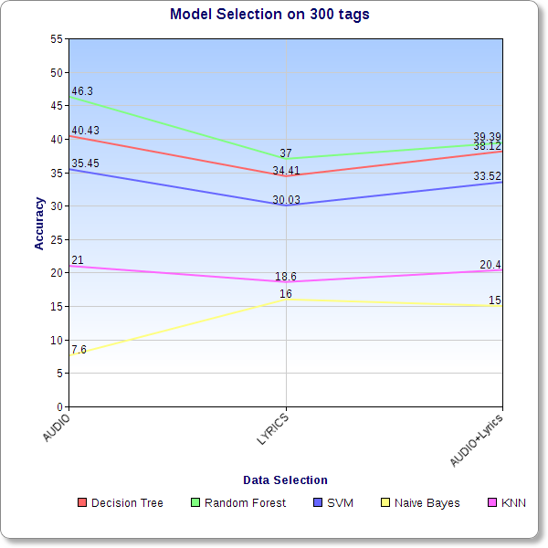
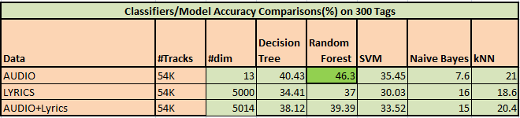
Setting Benchmarks... 300 tags(initially) !!

Slide 8
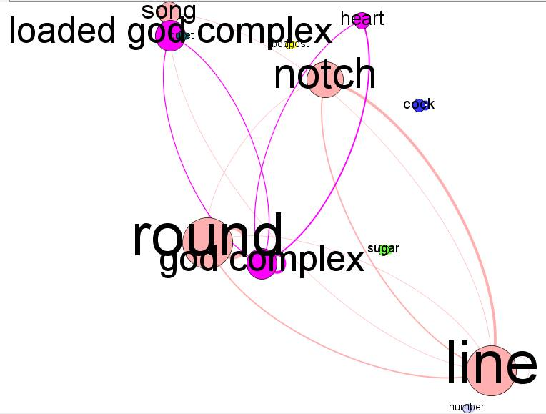
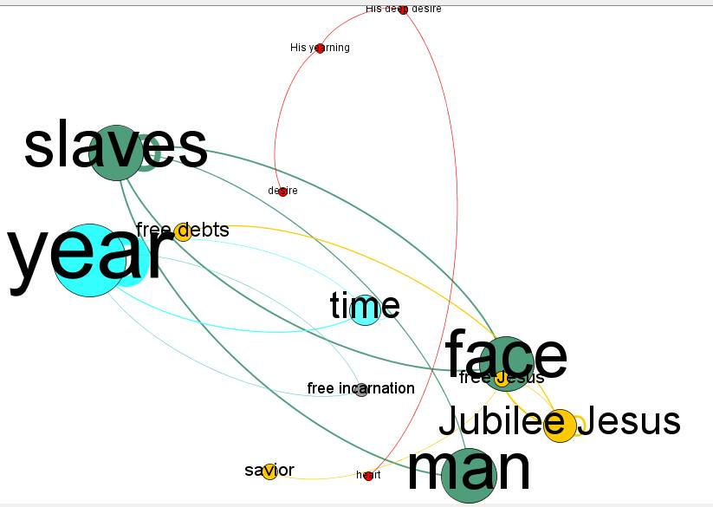
Feature Extraction
The list of 21 features extracted are:
1. count_Nouns 2. count_Verbs 3. count_Pronouns 4. count_Prepositions 5. count_Adverbs 6. count_Conjunctions 7. count_Modals 8. count_Adjectives 10 Polarity score (NOVEL IDEA) 11. G_score-Lexical chain score (NOVEL IDEA) 12. S_score-Lexical chain score (NOVEL IDEA) 13. count_hey 14. count_uh 15. count_ooh 16. count_ah 17. count_yo 18. count_yeah 19. wordcount 20. wordspermin 21. numcharperword
We also extracted the following rhyme features as :
22. count_AA_block 23. count_AABB_block 24. count_ABAB_block 25. count_ABAC_block 26. count_ABBA_block 27. count_AAAA_block
Lexical Analysis (Clustering)

Slide 9
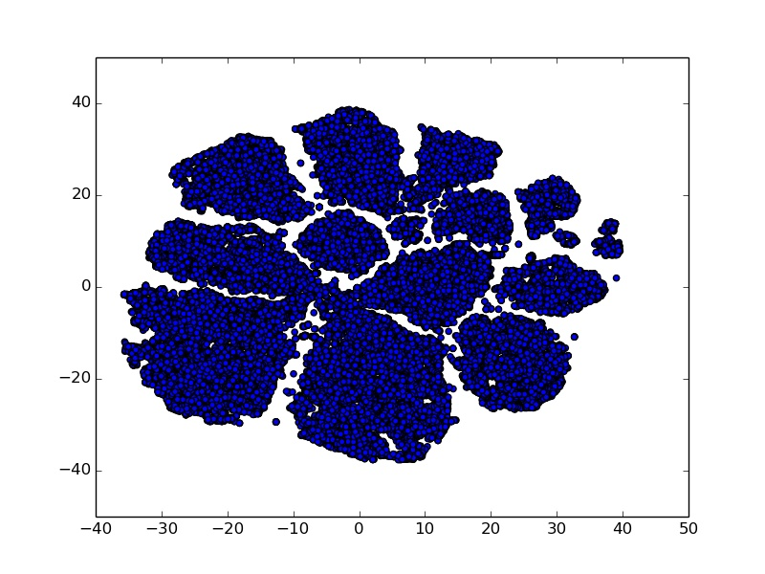
Reduced 13 tags
Worked on subset data 54K tracks while the complete Million Song dataset is sized 28GB
Approach for clustering 300 tags into 13 tags (E.g. POP + ROCK = POP_ROCK)
Tags
Blues country Electronic Folk International Jazz Latin New Age Pop_Rock Rap Reggae RnB Vocal

Slide 10
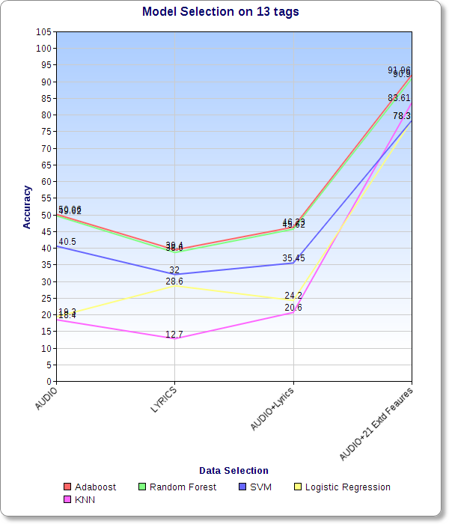
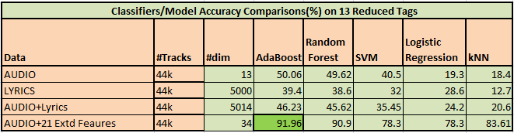
Model Selection on 13 Reduced Tags

Slide 11

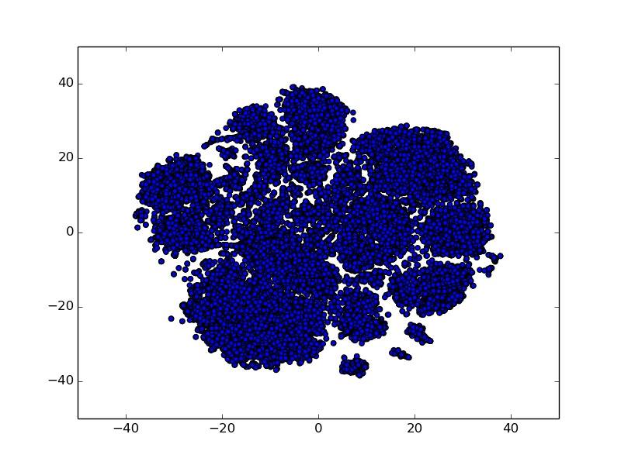
Towards 10 Tags....
Large number of POP_ROCK classes in 13 reduced tag data (Unbalanced)
Filter 54k to 28K tracks, selected Top 10 tags/Genres.
Uniform Distribution of Classes/tags.
Reference/Benchmark to compare our results.
Tags | Count
soul | 2190
rock | 8132
punk | 1846
pop | 3718
indie | 3145
folk | 1632
country | 3200
classic rock | 1886
blues | 1319
80s | 1765

Slide 12
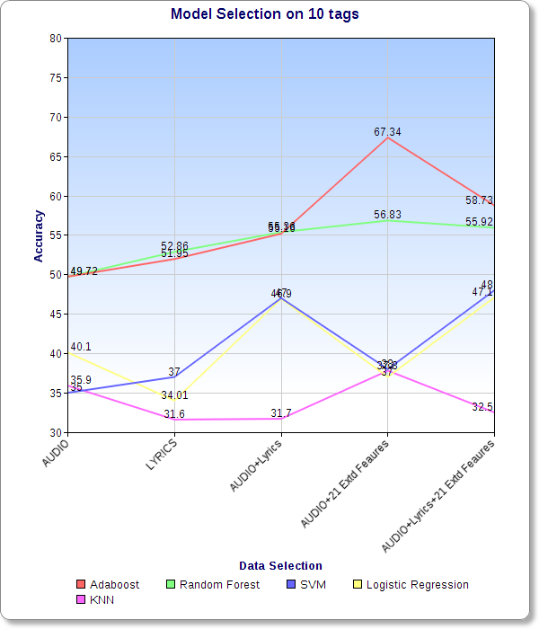
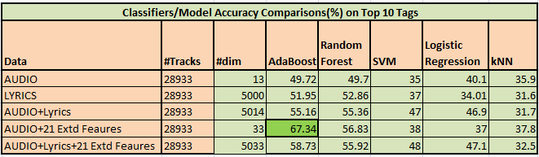
Model Selection for 10 tags

Slide 13
Hybrid Models(Random Forest/Feature Selection + Adaboost)
AUDIO Features
(CV score: 49.72%)
Feature Selection: GINI INDEX
TOP 30 Features
.
F
E
A T
U
R
E
UNION
AUDIO+EXT Features
(CV score: 60.08%)
Feature Selection: GINI INDEX
ADA-BOOST
Classifier
TOP 30 Features
63 Features
AUDIO + BOW
(CV score: 55.16%)
Feature Selection: GINI INDEX
TOP 50 Features
ACCURACY
AUDIO+BOW+EXT
(CV score: 58.73%)
Feature Selection: GINI INDEX
TOP 50 Features
68.11 %
+2.28%
(than published)

Slide 14
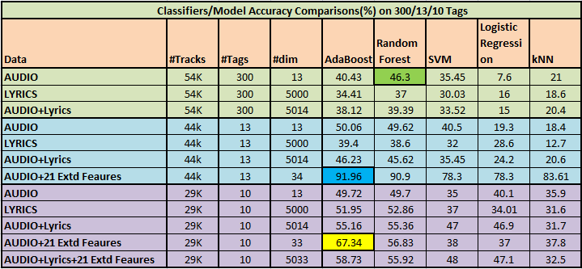
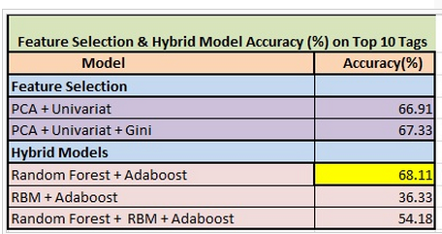
Summary - Results

Slide 15
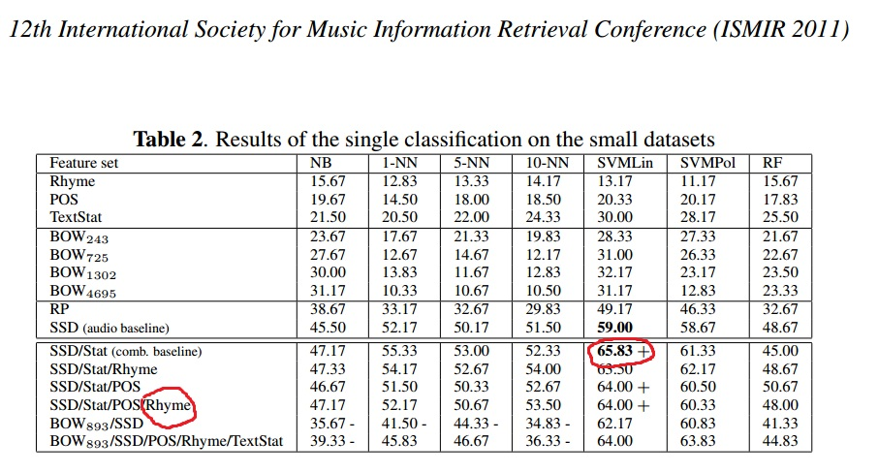
Our Results Vs Recent Research

Slide 16
SAP for Kiosk

Slide 17
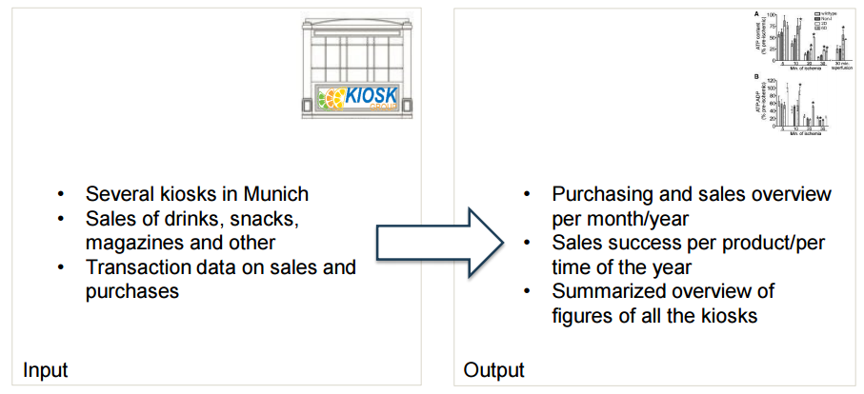
Customer Requirements

Slide 18
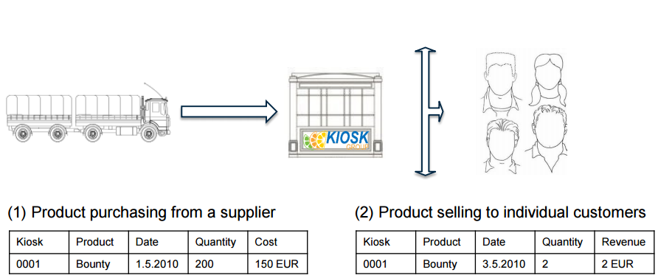
Customer main processes (simplified)

Slide 19
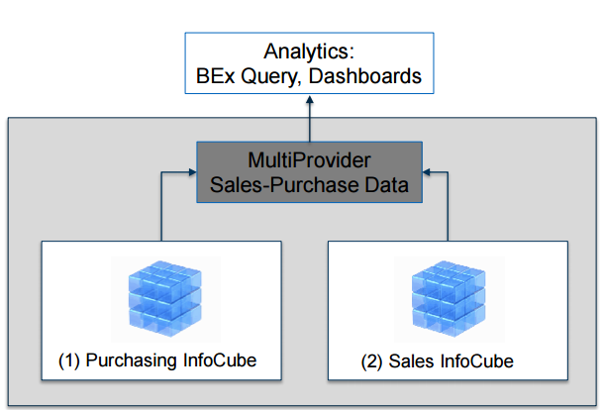
MultiProvider Solution

Slide 20
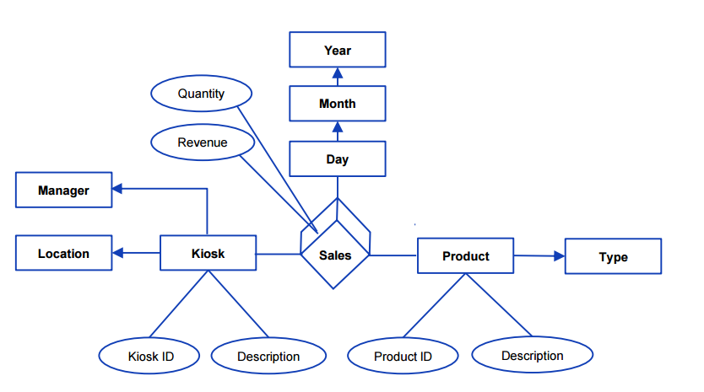
MERM: Sales InfoCube

Slide 21
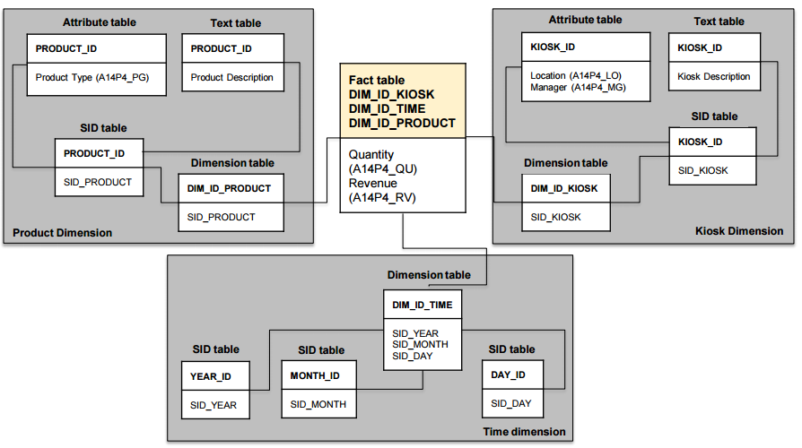
Star-schema: Sales InfoCube

Slide 22
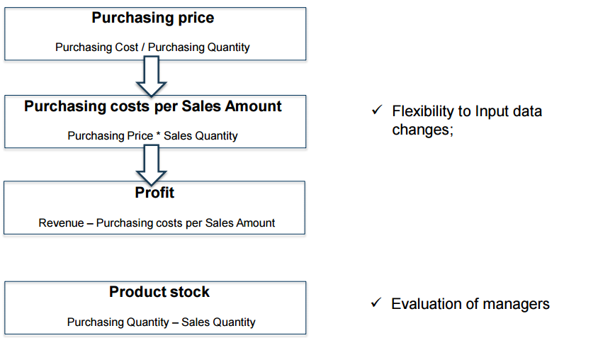
Calculated Key figures

Slide 23
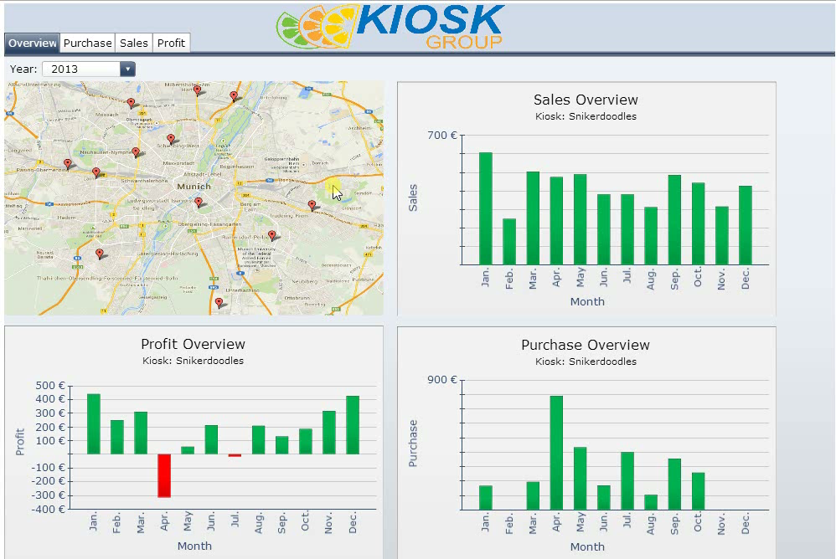
Demo

Slide 24
SAP for Healthcare

Slide 25
Introduction
- Facilitates the management of patient’s treatment.
It also provides the following :
Cooperation among staff members.
Focus on Patient treatment.
Avoids unnecessary organization issues.

Slide 26
Available Components
SAP Healthcare
Nurse
Doctor
Facility Management
Medicine
Administrator

Slide 27
Functional Requirements
Nurse
Register new patients and assign beds/room.
View and update Treatment plan
Doctor
Create New Treatment plans.
Overview and update patients status.
Administrator
CRUD of patients, beds, treatment plans and medications.

Slide 28
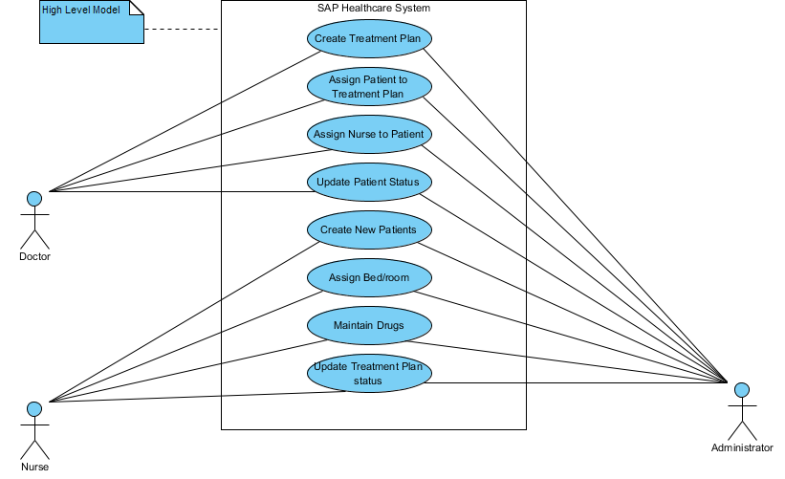
Use case : Overview

Slide 29
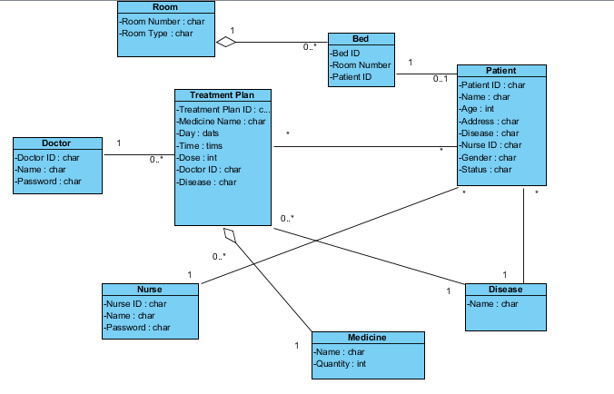
Data Modeling

Slide 30
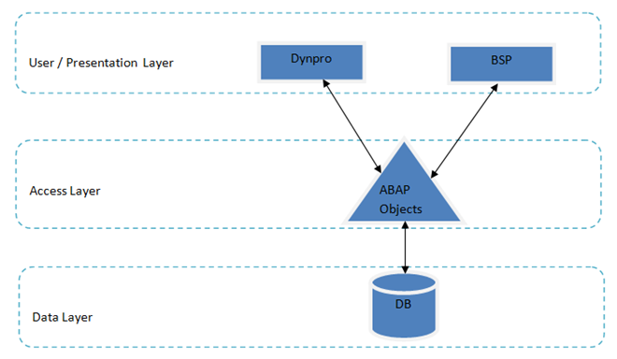
Software Architecture
ROLE | APPLICATION
Administrator | Dynpro
Doctors | BSP
Nurses

Slide 31
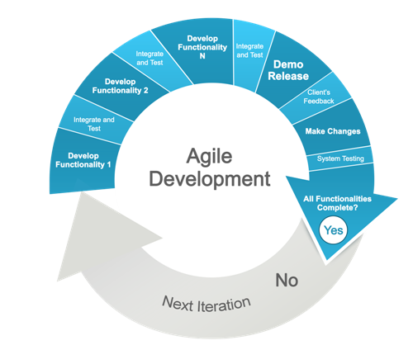
Software Architecture
Flexibility / Agility
Quality
Right Product
Source : http://www.pixeldust.net/agile-development-drupal-8

Slide 32
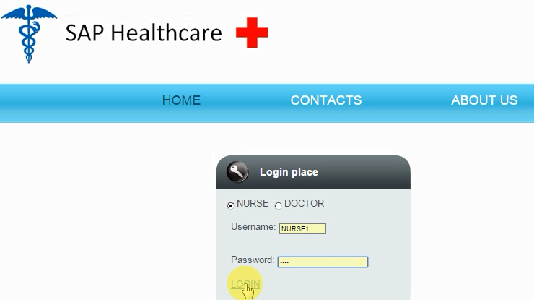
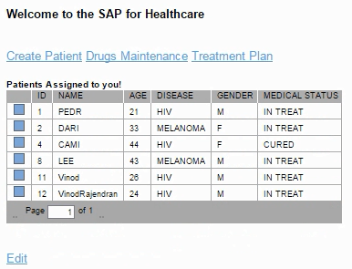
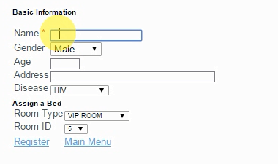
Nurse – Demo

Slide 33
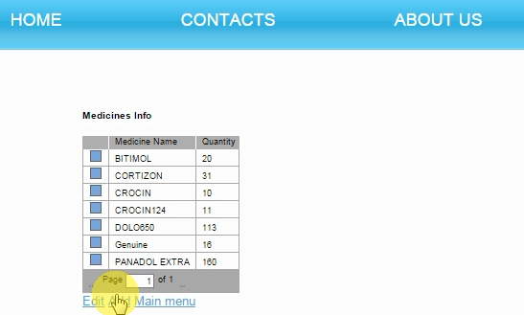
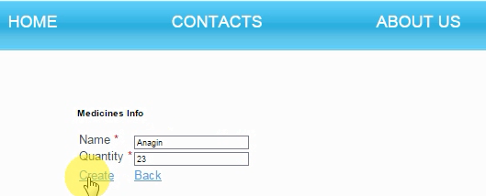
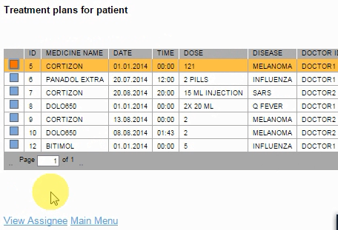
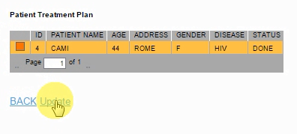
Nurse – Demo

Slide 34
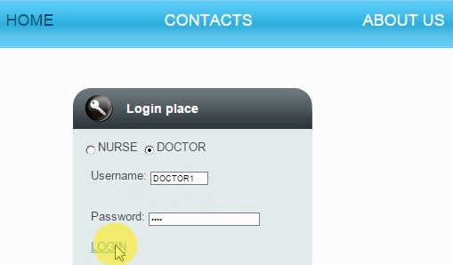
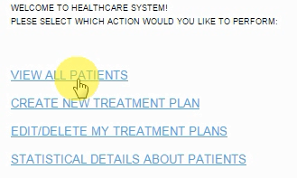
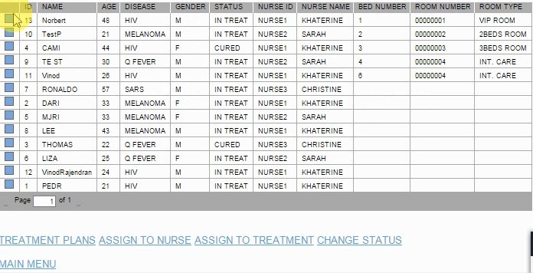
Doctor – Demo

Slide 35
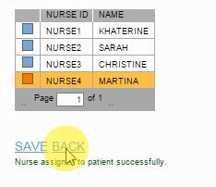
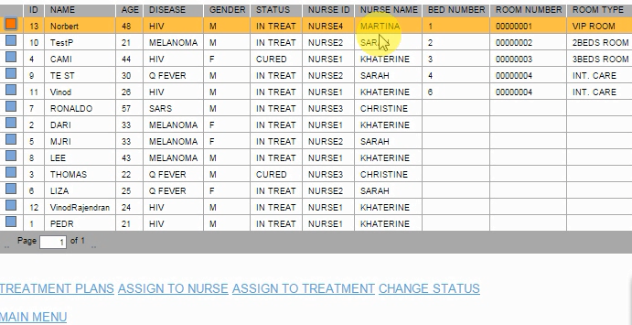
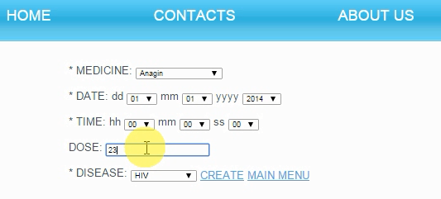
Doctor – Demo

Slide 36
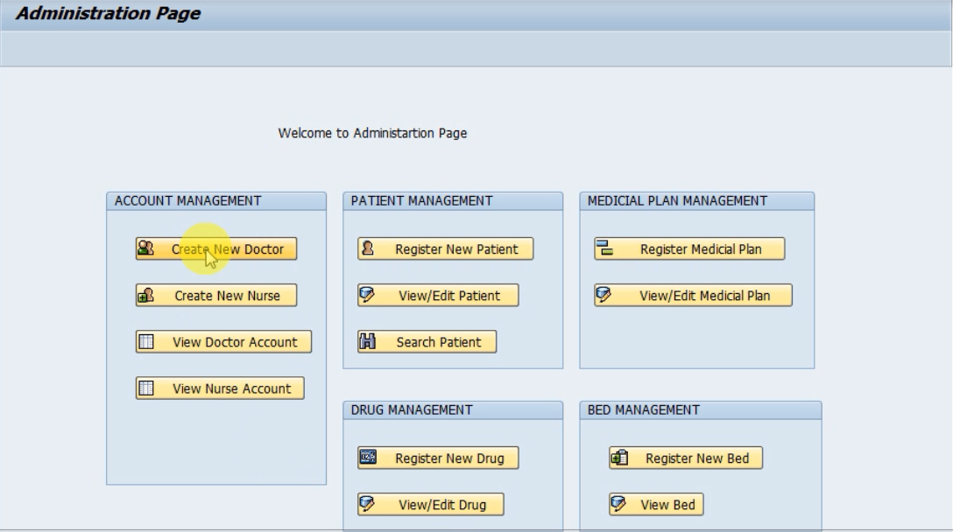
Administrator - Demo

Slide 37
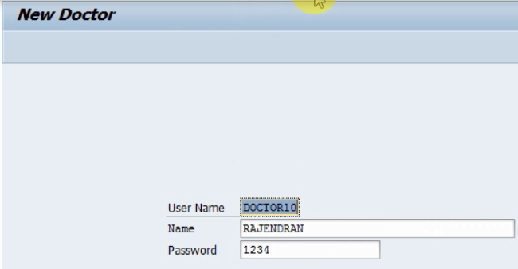
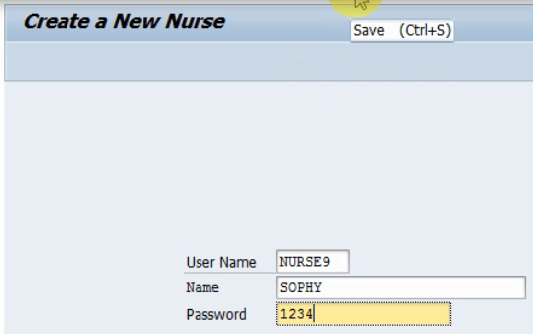
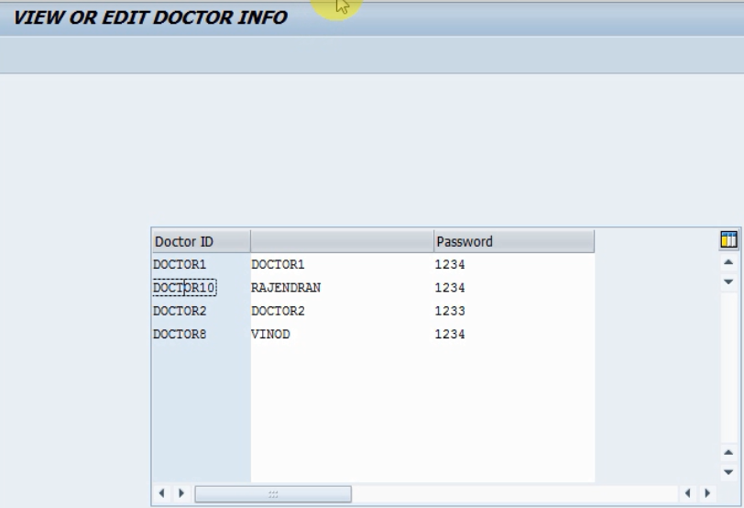
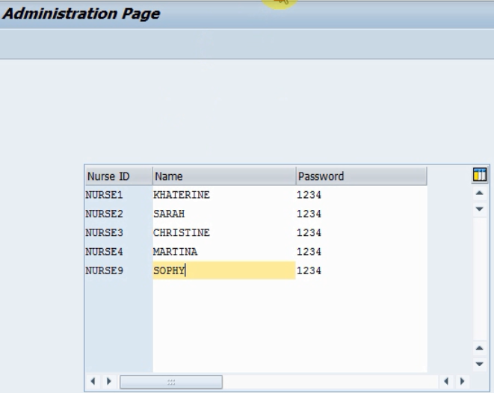
Administrator - Demo

Slide 38
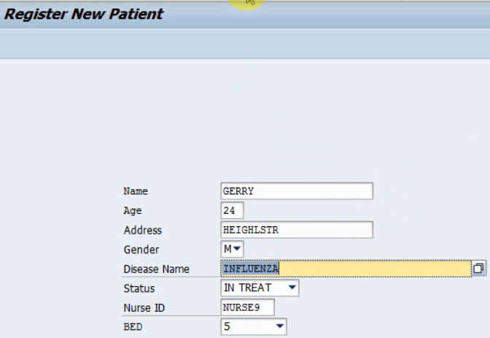
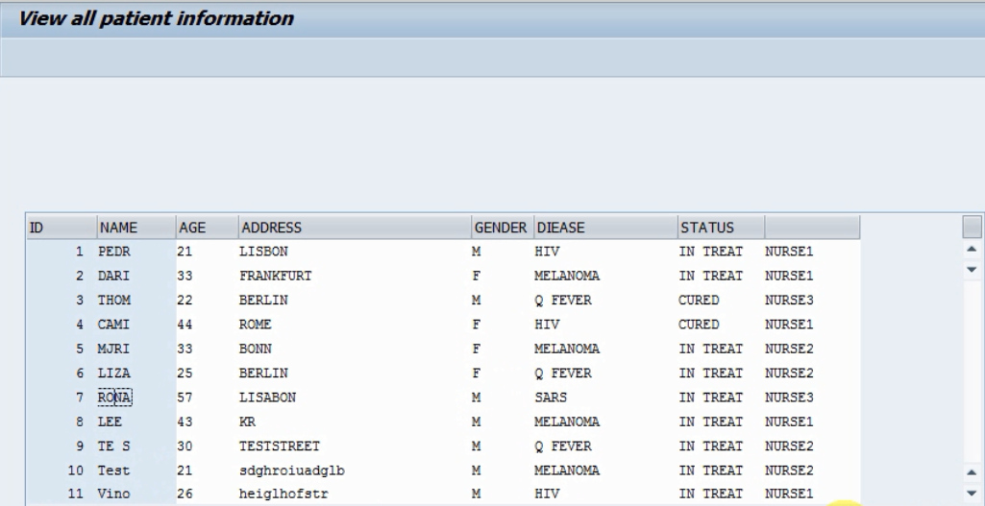
Administrator - Demo

Slide 39
Visualization of iAnn events

Slide 40
What is the project?
iAnn is an open source community-driven platform for dissemination of life science announcements, such as courses, conferences and workshops.
Why we are doing it ?
Save time, effort, cost of manual announcement curation for scientific organizations.
Facilitate sharing and promotion of scientific announcements.
Published on BioJs
Visualization Components: 3D Globe, Bilevel partition and TreeMap partition available for free.
http://biojs.io/d/biojs-vis-globemap
http://biojs.io/d/treemap
http://biojs.io/d/bilevel

Slide 41
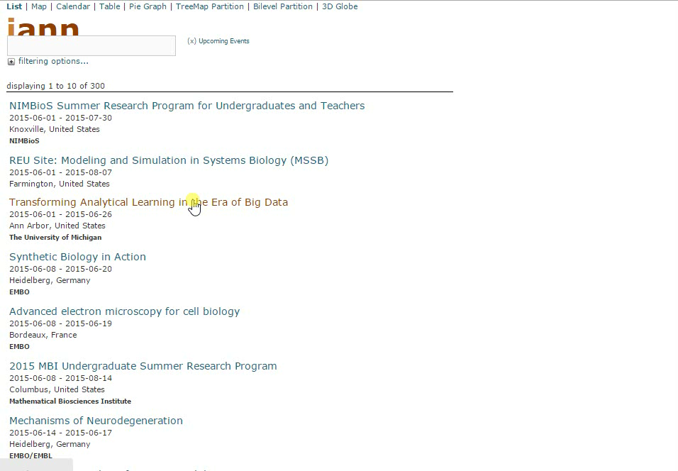
Demo

Slide 42
Seminar: NLP on Legal Science

Slide 43
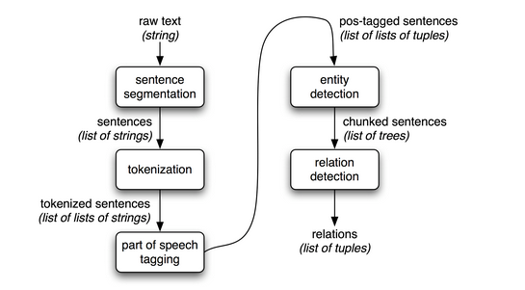
NLP Pipeline
Copyright © Natural Language Processing with Python, by Steven Bird, et.al.

Slide 44

Text Classification
Case Document
Categories of Law
Family
Criminal
Political
Commercial
Patent
Business
Health
…
?
Applications :
Recognition and tracking of named entities (mainly persons)
Classification of sentences of court decisions according to their rethorical role
Law Prediction

Slide 45


Text Summarization
Application:
Legal experts to determine the key idea of judgement.
Helps in organizing a large volume of documents.
[Dan Jurafsky & Chris Manning, Stanford University]

Slide 46
Work experience: TCS & ALLIANZ

Slide 47

TCS Bancs - Homepage
Responsible for developing and managing Calendar and Fees component.
Developing batch programs for Fees and Corporate Action components.

Slide 48

TCS Bancs – How the screen looks like ?

Slide 49



Jasper iReport
Design and Development of Reports.

Slide 50


SAS Reporting
Generation of Adhoc Reports.
Automation scripts for finding the differences in the reports.

Slide 51


Confluence & Jira Management
Design and management of confluence page for Reporting and Data Management Team.
Design of workflow status for JIRA.

Slide 52

Thank you for your attention!

